Slide 1
CS 314 Recitation 3
Eric Giovannini

Slide 2
Contents
HW1 questions?
More lambda calculus
Free and bound variables
Capture-free substitution
Basic programming constructs (time permitting)

Slide 3
HW 1

Slide 4
Expression Calculator
What should these expressions return?
3 4 5 * -
3 4 - 5 *
3 - (4 * 5) = -17
(3 - 4) * 5 = -5

Slide 5





Lambda Calculus Practice (from last time)
$$y$$
$\left(λx.x\right)y$
$\left(λx.z\right)y$
$\left(λx.x\right)\left(λy.y\right)$
$\left(λx.xz\right)\left(λx.y\right)$
$$z$$
$$\left(λy.y\right)$$
$$\left(λx.y\right)z→y$$

Slide 6

Free vs Bound Variables
$λy.xy$
Free: x
Bound: y
$λx.(λy.xy)$
Free: none
Bound: x, y
$\left(λx.x\right)x$
Free: x
Bound: x

Slide 7
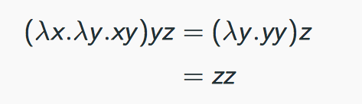
Capture-Free Substitution
Why is the below example incorrect:
We replaced the x with y, so it got “captured” by the $λy$

Slide 8
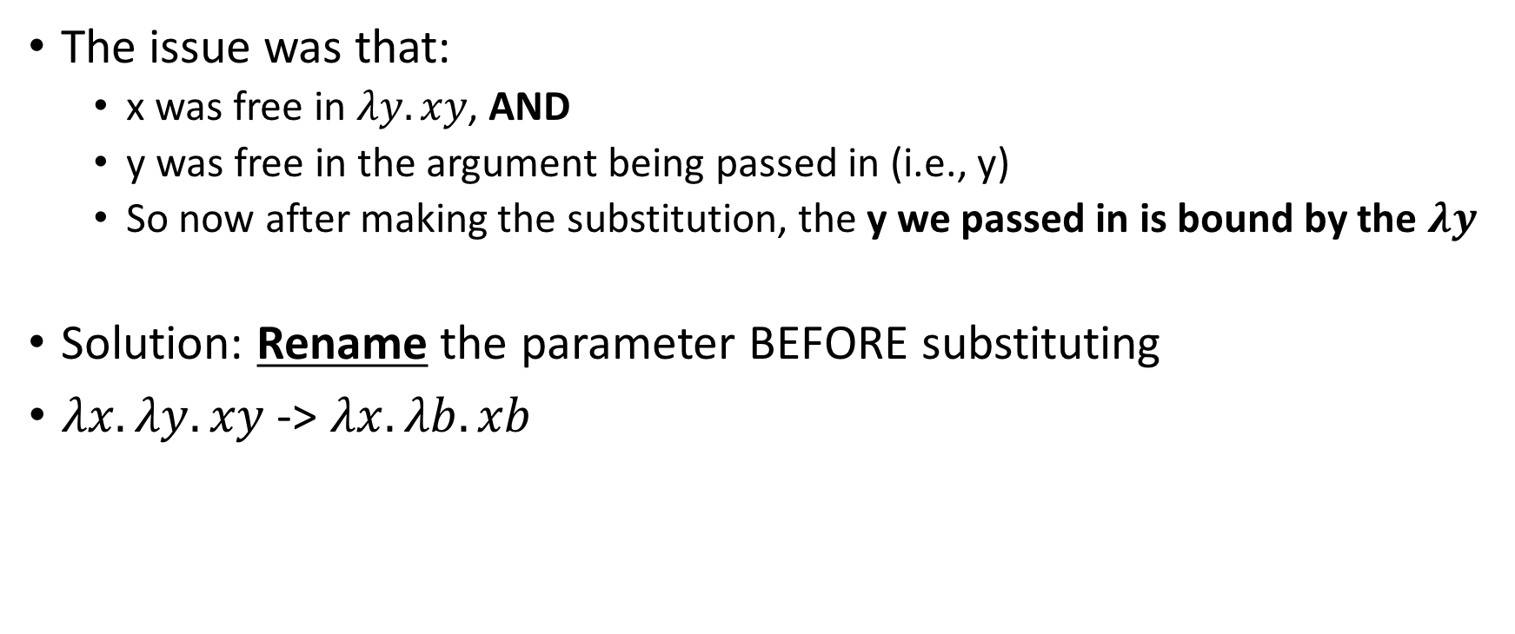
Capture-Free Substitution
The issue was that:
x was free in $λy.xy$, AND
y was free in the argument being passed in (i.e., y)
So now after making the substitution, the y we passed in is bound by the $λy$
Solution: Rename the parameter BEFORE substituting
$λx.λy.xy$ -> $λx.λb.xb$

Slide 9
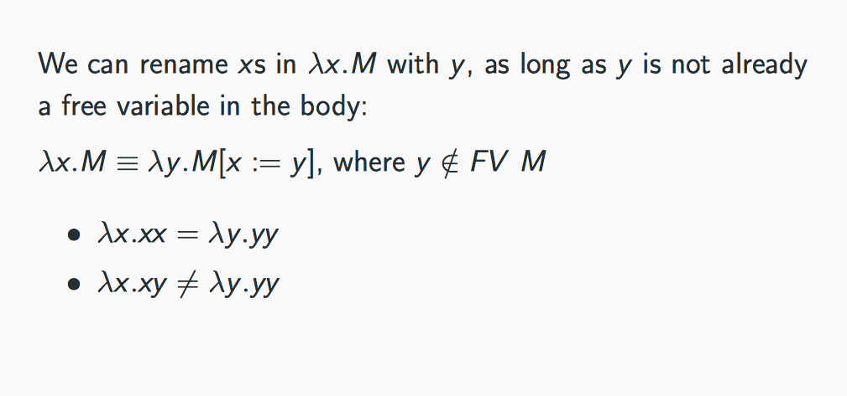
When can we Rename?

Slide 10
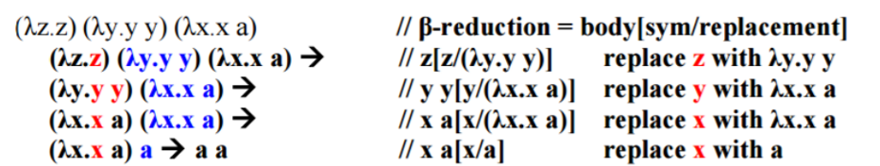
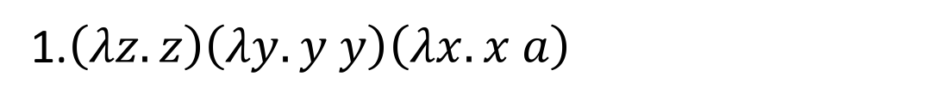
Lambda Calculus Practice
1.$\left(λz.z\right)\left(λy.y y\right)\left(λx.x a\right)$

Slide 11
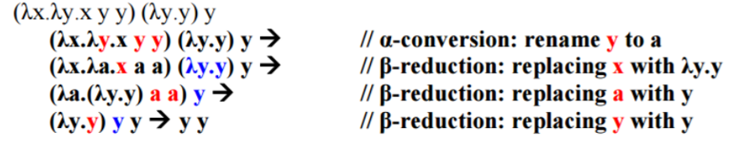
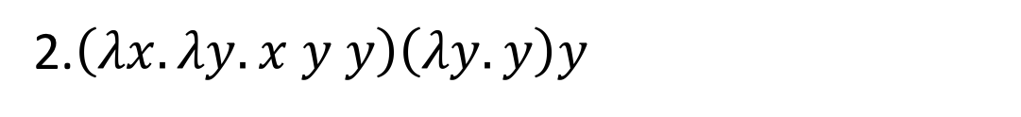
Lambda Calculus Practice
2.$\left(λx.λy.x y y\right)\left(λy.y\right)y$

